Slide 1
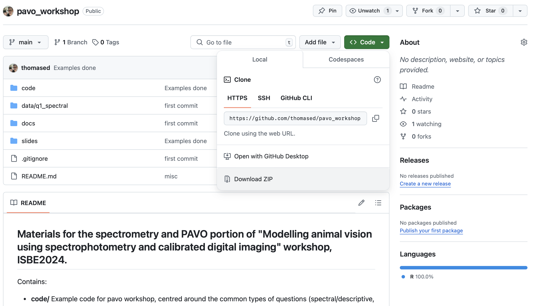
Today: materials
https://github.com/thomased/pavo_workshop

Slide 2

PAVO
An introduction and overview

Slide 3
Package aim
A flexible and integrated workflow for working with spectral and spatial colour data.

Slide 4
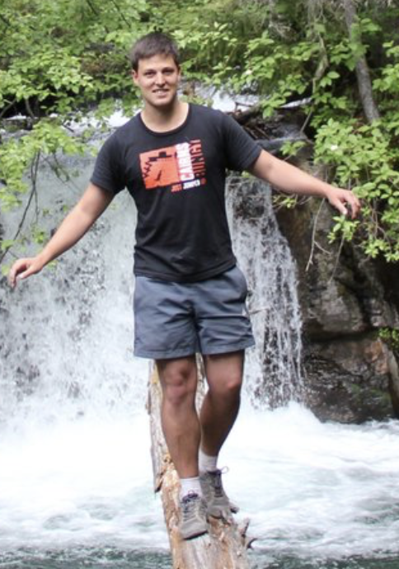
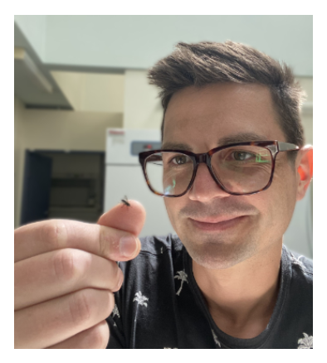
History & team
~2012 -> Inception
2013 -> v0.5. Maia et al. (2013) original paper
~2013 -> I joined. v 1.0.
~2017 -> Hugo aboard
~2019 -> Maia et al. (2019) v2 paper
Present -> v2.9.0
Thomas White
Hugo Gruson
Rafael Maia
Chad Eliason
Pierre-Paul Bitton
Matthew Shawkey
Stephanie Doucet

Slide 5
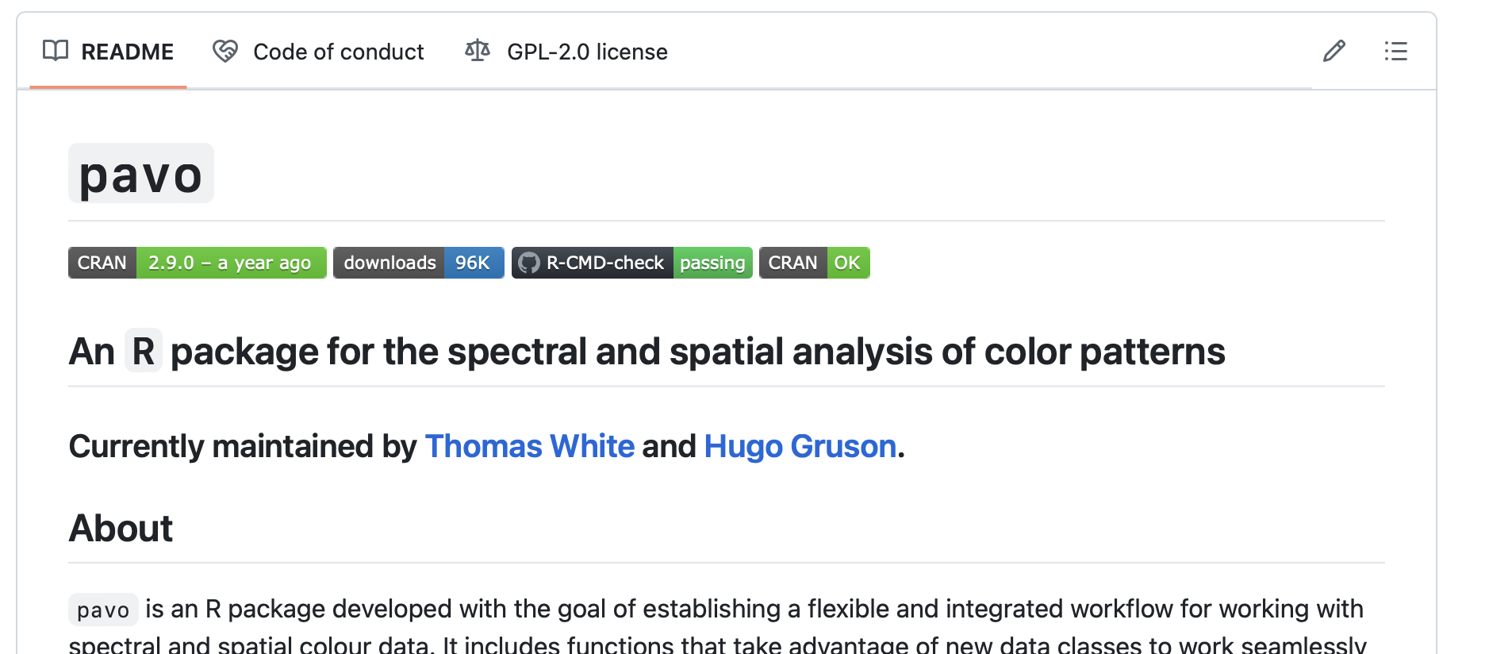
Installation
current release
install.packages("pavo")
development version
remotes::install_github("rmaia/pavo")
https://github.com/rmaia/pavo

Slide 6
Workflow
Organisation
Visualisation
Analysis

Slide 7
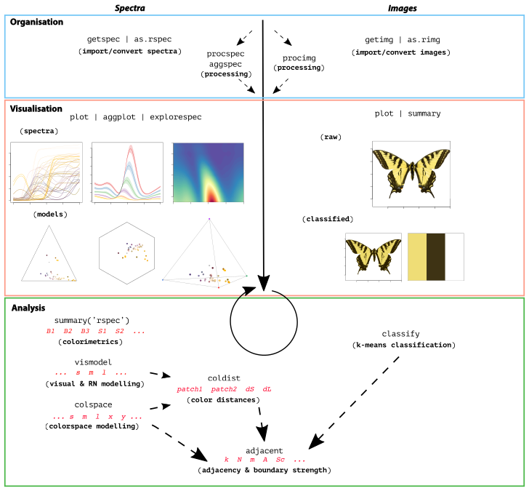
Workflow

Slide 8
Quick aside
PAVO’s rich ‘generic’ system
plot(),
summary(),
merge()
is.rspec(), as.rspec()
...works on most stuff
Help is at hand
?function – for individual help docs
http://pavo.colrverse.com

Slide 9
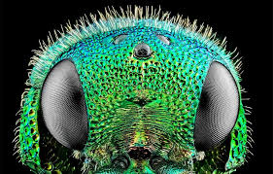
Organisation
getspec() – import and load diverse spectral data formats. Uses package lightR under the hood.
as.rspec() – convert to rspec object, bin, trim/expand wavelength limits
aggspec() – aggregate spectra
procspec() – process spectra via smoothing, fix negative values, binning, normalising...
merge(), subset() – chop/merge
simulate_spec() – fun new one to simulate spectral curves
getimg(), procimg(), as.rimg() – analogous functions for images

Slide 10
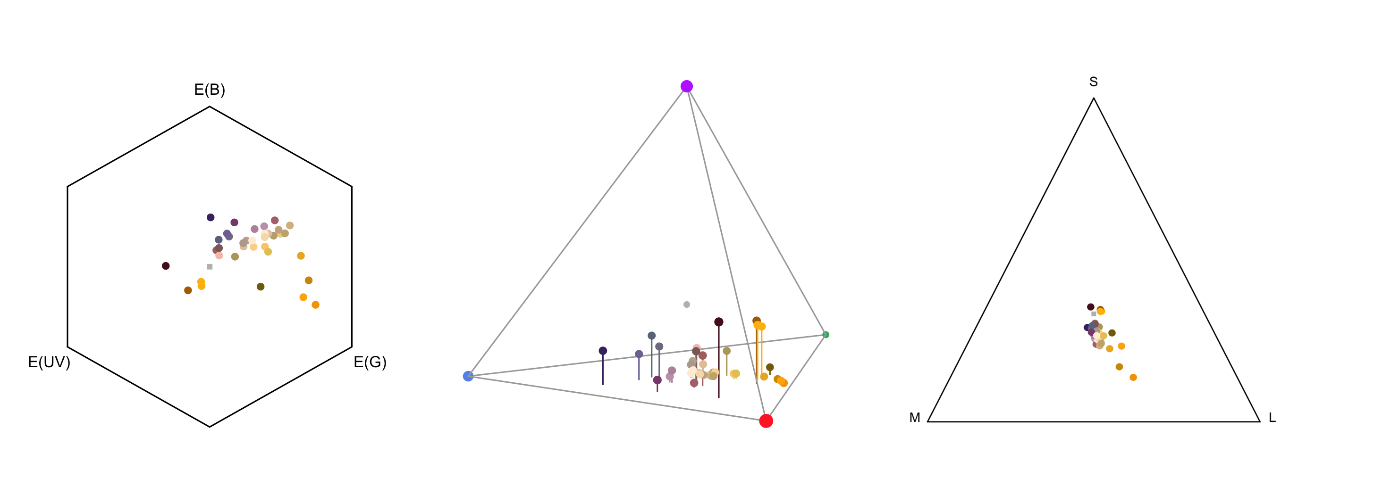
Visualisation
plot() – try it on whatever, pavo will do its best

Slide 11
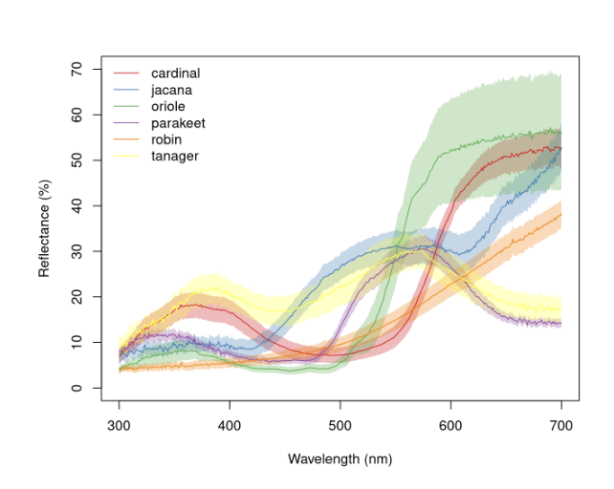
Visualisation: specialised stuff
aggplot() – aggregated spectra
explorespec() – quickly explore groups of spectra
plotsmooth() – explore different levels of smoothing
tcsplot() – interactive tetrahedral plot
projplot() – 2d projection of tetrahedral plot
sensdata(..., plot = TRUE) – Explore built-in spectra

Slide 12
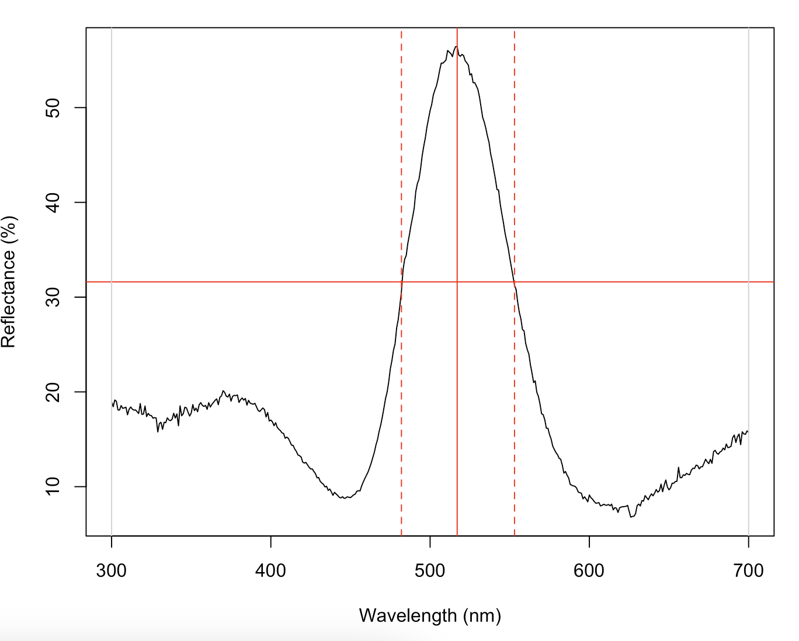
Analysis: spectral
summary() – again, try it on anything
- rspec and colspace objects
- 23 summary standard colourimetric descriptors of ‘hue’, ‘saturation’, and ‘brightness’
peakshape() – Standard measures of height, location, width of a spectral peak

Slide 13
Analysis: visual modelling
Most-used
vismodel() – estimating cone/quantum catches for RN and colourspace models
colspace() – implementing colourspace models.
Generic n-dimensional, hexagon, ‘categorical’ space (Troje), COC, CIE models
coldist() & bootcoldist() – calculating colour distances (all models/spaces)

Slide 14
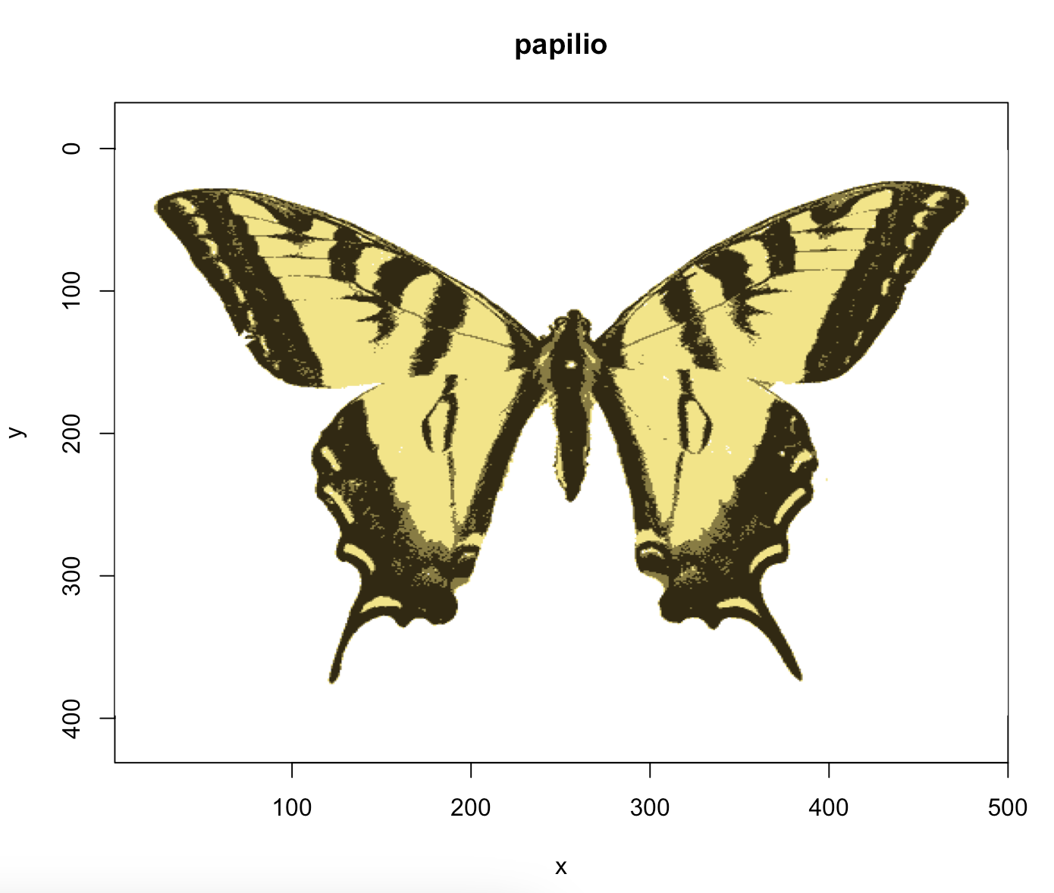
Analysis: visual modelling
Others
vol() and voloverlap() – estimate ‘colour volumes’
and their overlaps
classify() – colour classification of images
adjacent() – pattern contrast, adjacency,
and boundary-strength analyses

Slide 15
Analysis: visual modelling
Utility
sensmodel() – modelling receptor absorbances
sensdata() — checking out the build-in data (raw or plotted)
flux2irrad() — convert between photon flux and irradiance
jnd2xyz() – convert noise-weighted colour distances to x-y-z coordinates in Cartesian space
coldist2mat() – convert colour distances between samples into a distance matrix

Slide 16
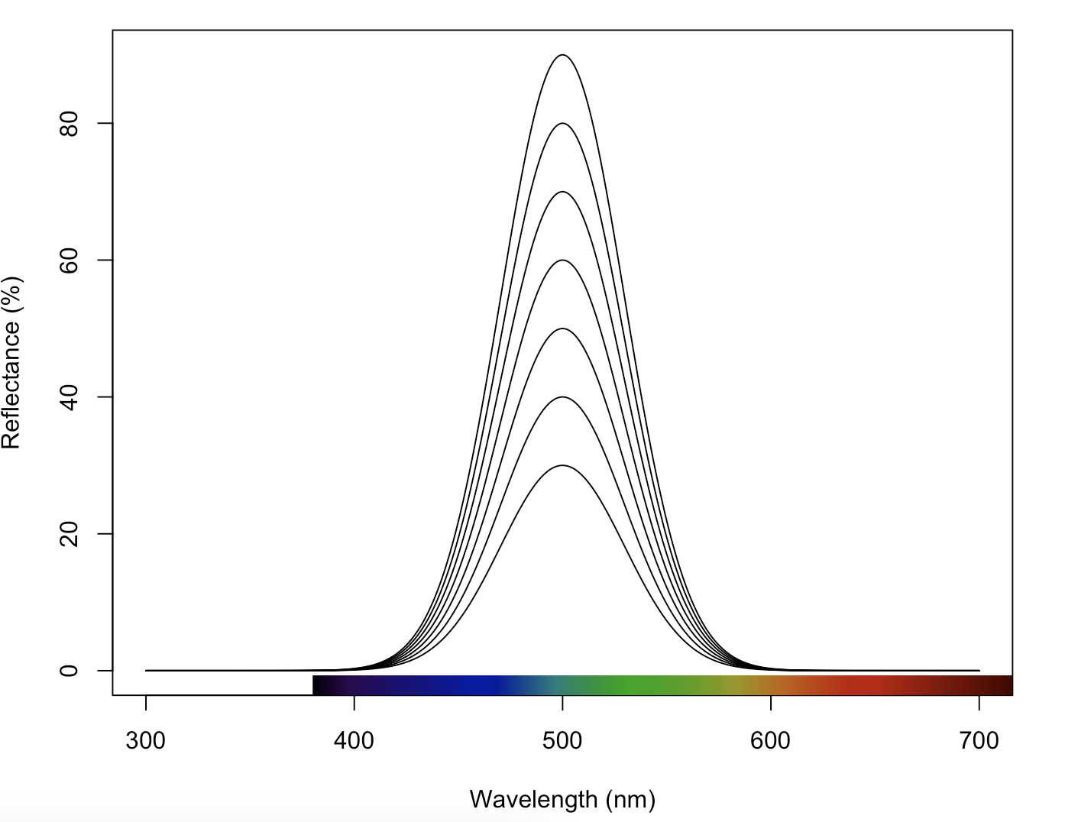
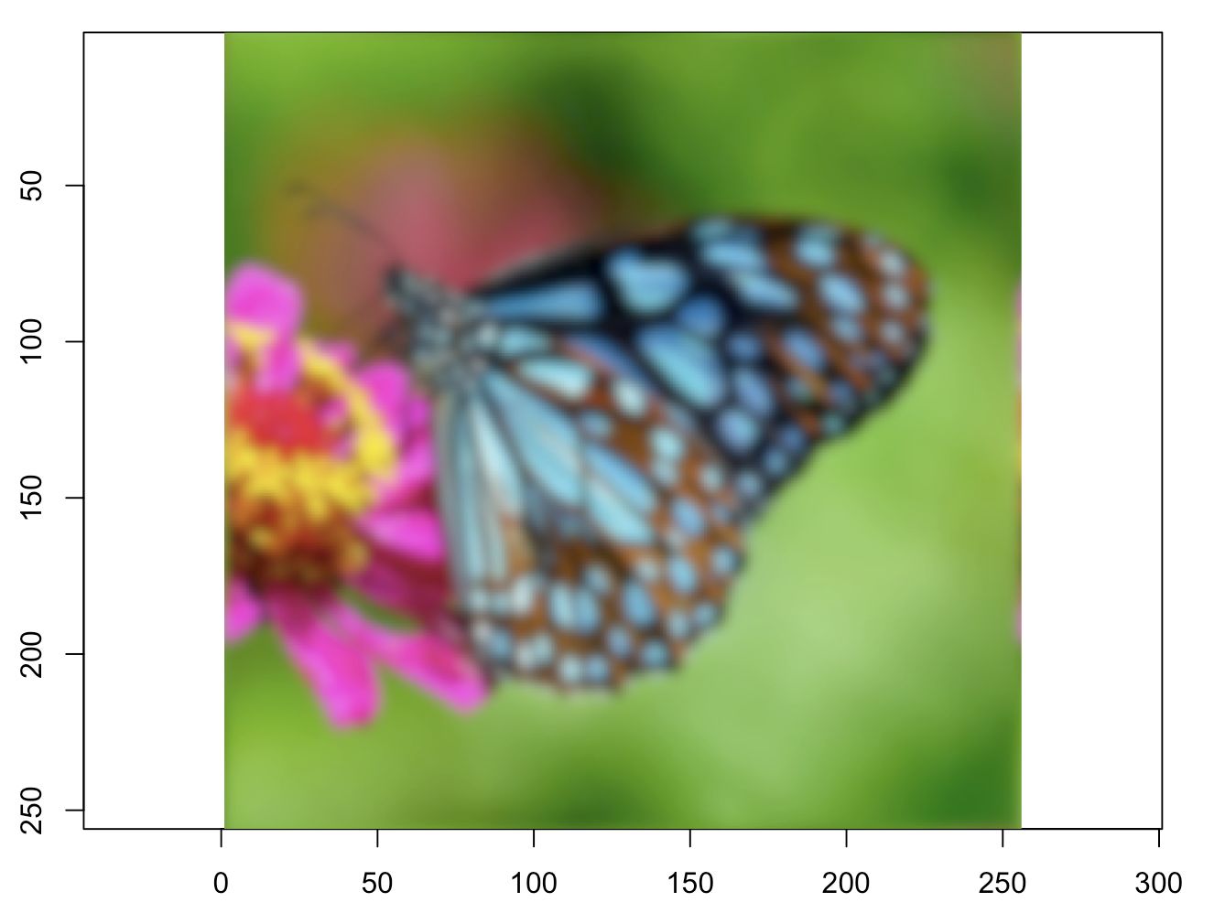
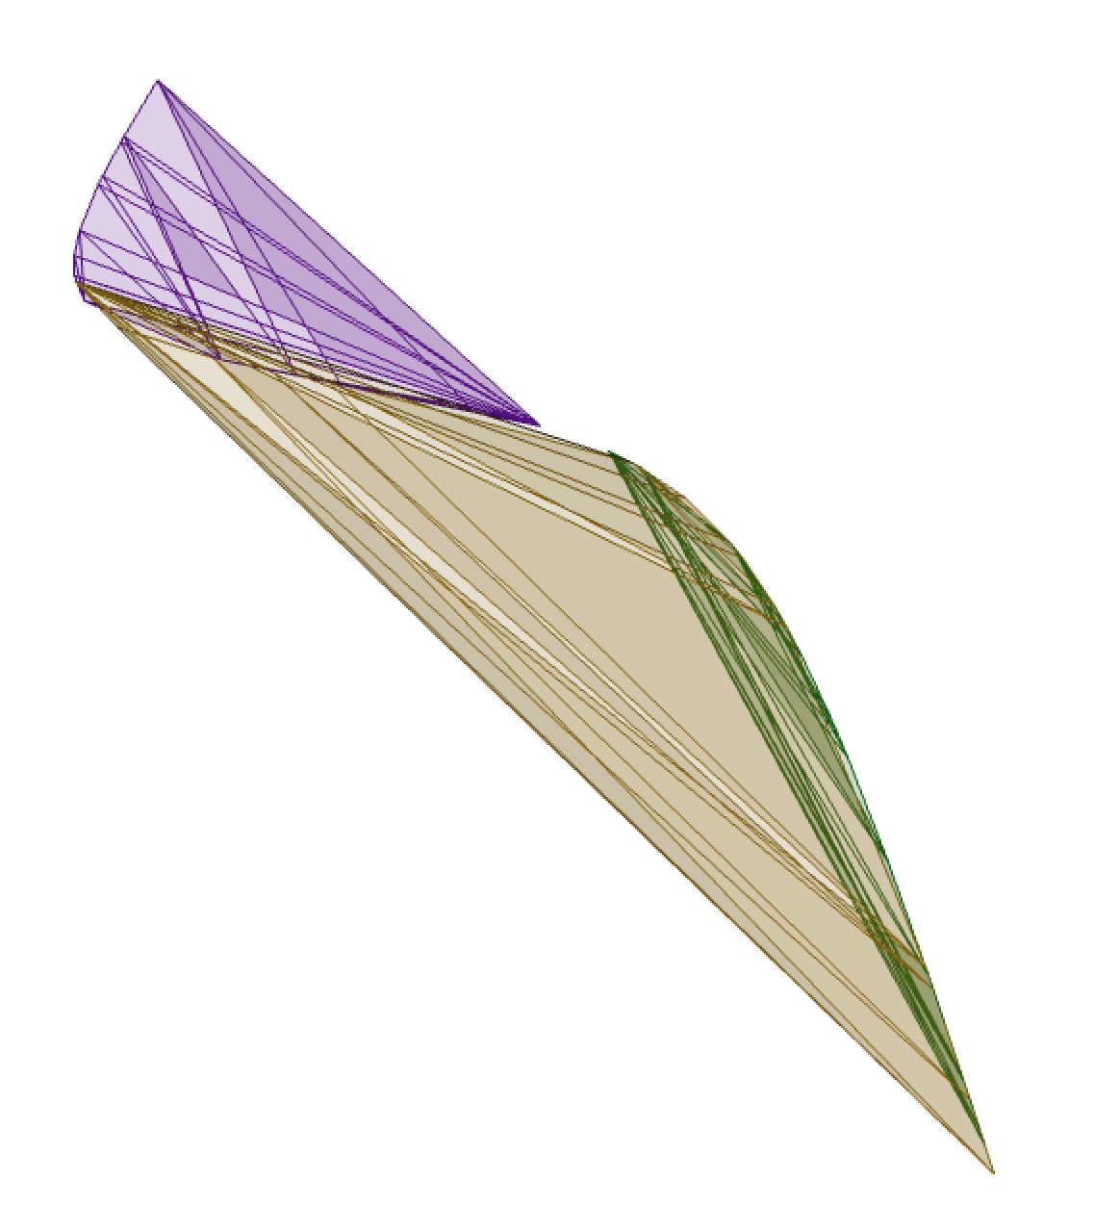
Newish stuff summary (up to v.2.9.0)
simulate_spec()
procimg() acuity modelling
tcsvol() alpha shapres

Slide 17
TODO
sensmodel() expansion for alternate methods
stitch.rspec() for row-wise stitching (e.g. UV-VIS + NIR specs)
weighted + hierarchical bootcoldist()
change-point analyses for spectra
more absorbance (viewer) & illuminant spectra, possibly a database of ‘em
various QOL improvements
What do you want?

Slide 18
Today’s goal
Develop a sense of the major functionality of PAVO and spectrometry-based methods,
via some representative biological questions

Slide 19
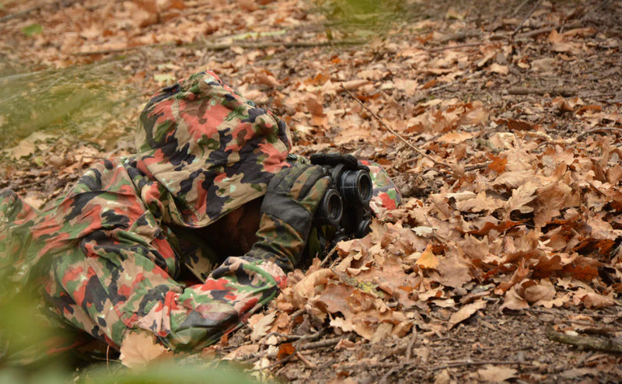
Today: question-driven examples
(1) Spectral/physical
(2) Discrimination
(3) Perceptual distance
Kemp et al. (2015). An integrative framework for the appraisal of coloration in nature.
The American Naturalist, 185(6), 705-724.

Slide 20
Today
https://github.com/thomased/pavo_workshop

